Slide 1
OMR
Optical Mark Reader

Slide 2
OMR
OMR technology detects the absence or presence of a mark, but not the shape of the mark.
Optical mark recognition is the process of capturing data by contrasting reflectivity at predetermined positions on a page

Slide 3
OMR
The infra-red light is not reflected when it scans over a mark and the position of the mark is passed back to the computer. The software then matches up the position of the mark with the information on the sheet
This provides a very fast and accurate method of inputting large amounts of data, provided the marks have been made accurately and clearly.

Slide 4
Application
Data compilation
Consumer surveys
Time sheet / inventory counts
In the process of institutional research
Community surveys
Product evaluation
Test assessment
Membership subscripting forms
Evaluation / Feedback
Lotteries / Voting

Slide 5


Barcode Form

Slide 6
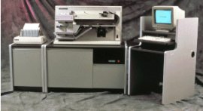

OMR Scanner

Slide 7
OCR
Optical Character Reader

Slide 8
OCR
Optical character recognition, usually abbreviated to OCR, is a type of computer software designed to translate images of handwritten or typewritten text (usually captured by a scanner) into machine-editable text, or to translate pictures of characters into a standard encoding scheme representing them (e.g. ASCII or Unicode).

Slide 9
Why it is necessary
Suppose you wanted to digitize a magazine article or a printed contract. You could spend hours retyping and then correcting misprints. Or you could convert all the required materials into digital format in several minutes using a scanner (or a digital camera) and Optical Character Recognition technology.

Slide 10
How Does OCR Work?
There are two basic methods used for OCR: Matrix matching and feature extraction. Of the two ways to recognize characters, matrix matching is the simpler and more common.
Matrix Matching compares what the OCR scanner sees as a character with a library of character matrices or templates. When an image matches one of these prescribed matrices of dots within a given level of similarity, the computer labels that image as the corresponding ASCII character.

Slide 11
How Does OCR Work? (Cont..)
Feature Extraction is OCR without strict matching to prescribed templates. Also known as Intelligent Character Recognition (ICR), or Topological Feature Analysis, this method varies by how much "computer intelligence" is applied by the manufacturer. The computer looks for general features such as open areas, closed shapes, diagonal lines, line intersections, etc. This method is much more versatile than matrix matching. Matrix matching works best when the OCR encounters a limited repertoire of type styles, with little or no variation within each style. Where the characters are less predictable, feature, or topographical analysis is superior.

Slide 12
Operation
In OCR processing, the scanned-in image or bitmap is analyzed for light and dark areas in order to identify each alphabetic letter or numeric digit.
Character is recognized using OCR software,
Then it is converted into an ASCII code for further Edit.

Slide 13
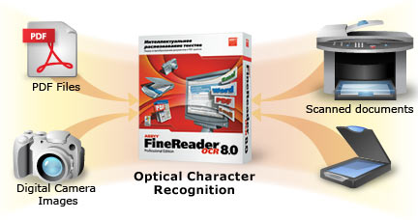
OCR System

Slide 14
Application
OCR is being used:
  Libraries to digitize and preserve their holdings.
  OCR is also used to process checks and credit card slips and sort the mail.
  Billions of magazines and letters are sorted every day by OCR machines, considerably speeding up mail delivery.

Slide 15

OCRA Font

Slide 16

OCRB Font

Slide 17
MICR
Magnetic Ink Character Reader

Slide 18
MICR
Magnetic Ink Character Recognition is a character recognition system that uses special ink and characters. When a document that contains this ink needs to be read, it passes through a machine, which magnetizes the ink and then translates the magnetic information into characters.

Slide 19
Application
MICR technology is used by banks.
Numbers and characters found on the bottom of checks (usually containing the check number, sort number, and account number) are printed using Magnetic Ink.
To print Magnetic Ink, you need a laser printer that accepts MICR toner.
MICR provides a secure, high-speed method of scanning and processing information.

Slide 20


Bank Check

Slide 21
MICR Font
E13B font
CMC7 Font

Slide 22
E13B font
Used in USA
Also used in England
Ten numerals (0-9) but no alpha character
4 special Character

Slide 23
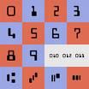
E13B font
Bank Branch amount on USA dash

Slide 24

E13B font

Slide 25

CMC7 Font
Used in Europe
Number, special character and letters are included
Each character is represented by 7 vertical bars.

Slide 26
CMC7 Font
The six spaces between 7 bars are binary values.
  Narrow space= 0
  Wide space=1
2^6 = 64 characters are possible
CMC7 use only 41 Characters

Slide 27


CMC7 Font

Slide 28


MICR Printer

Slide 29
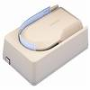
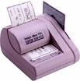
MICR Scanner

